Slide 1
Clustering
Advanced Machine Learning
Data Science at Zindua School | By Chris Aloo

Slide 2
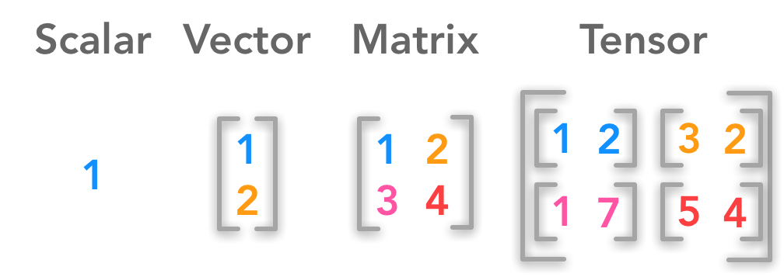
Brain Teaser
?
?

Slide 3
Brain Teaser

Slide 4
Introduction to Clustering

Slide 5
Introduction to Clustering
Unsupervised Learning Models
What is Clustering
Types of Clustering Models
  Partitioning/Centroid Based
  Hierarchical
  Density Based
  Distribution Based
Applications of Clustering
Notion of Similarity/Distance
  Statistical Distance
  Semantic Similarity
Evaluation Metrics

Slide 6
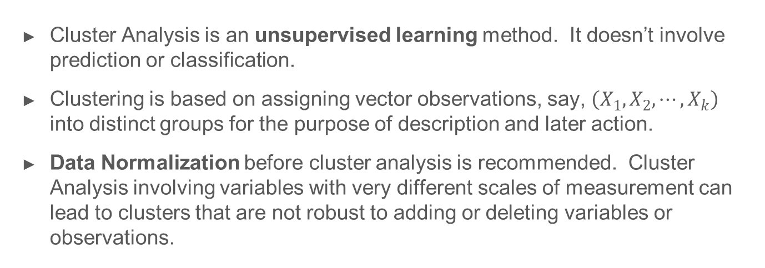
What is Clustering
Cluster Analysis is an unsupervised learning method. It doesn’t involve prediction or classification.
Clustering is based on assigning vector observations, say, $\left(X_{1}, X_{2}, ⋯, X_{k}\right)$ into distinct groups for the purpose of description and later action.
Data Normalization before cluster analysis is recommended. Cluster Analysis involving variables with very different scales of measurement can lead to clusters that are not robust to adding or deleting variables or observations.

Slide 7
Types of Clustering Models
Types of Clustering Models
  Partitioning/Centroid Based : K-Means
  Hierarchical : Divisive, Agglomerative
  Density Based : DBSCAN, DENCLUE
  Distribution Based : Gaussian Mixture Models (GMM)
Choosing the Right Model : Considerations
  Data Shape and Data Distribution
  Number of Clusters
  Computational Resources
  Interpretability
  Presence of Outliers
  Desired Cluster Characteristics

Slide 8

Application of Clustering

Slide 9
K-Means Clustering

Slide 10

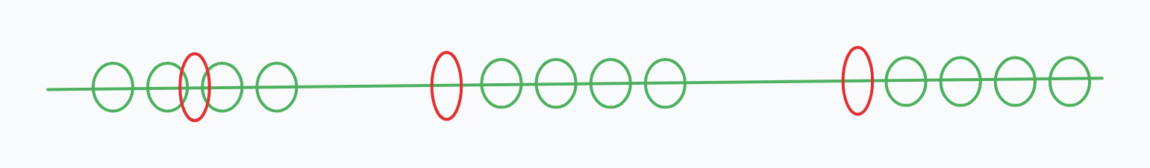

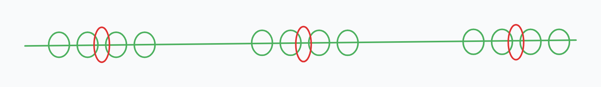

Steps in the Algorithm

Slide 11
Steps in the Algorithm
How do you calculate distance

Slide 12
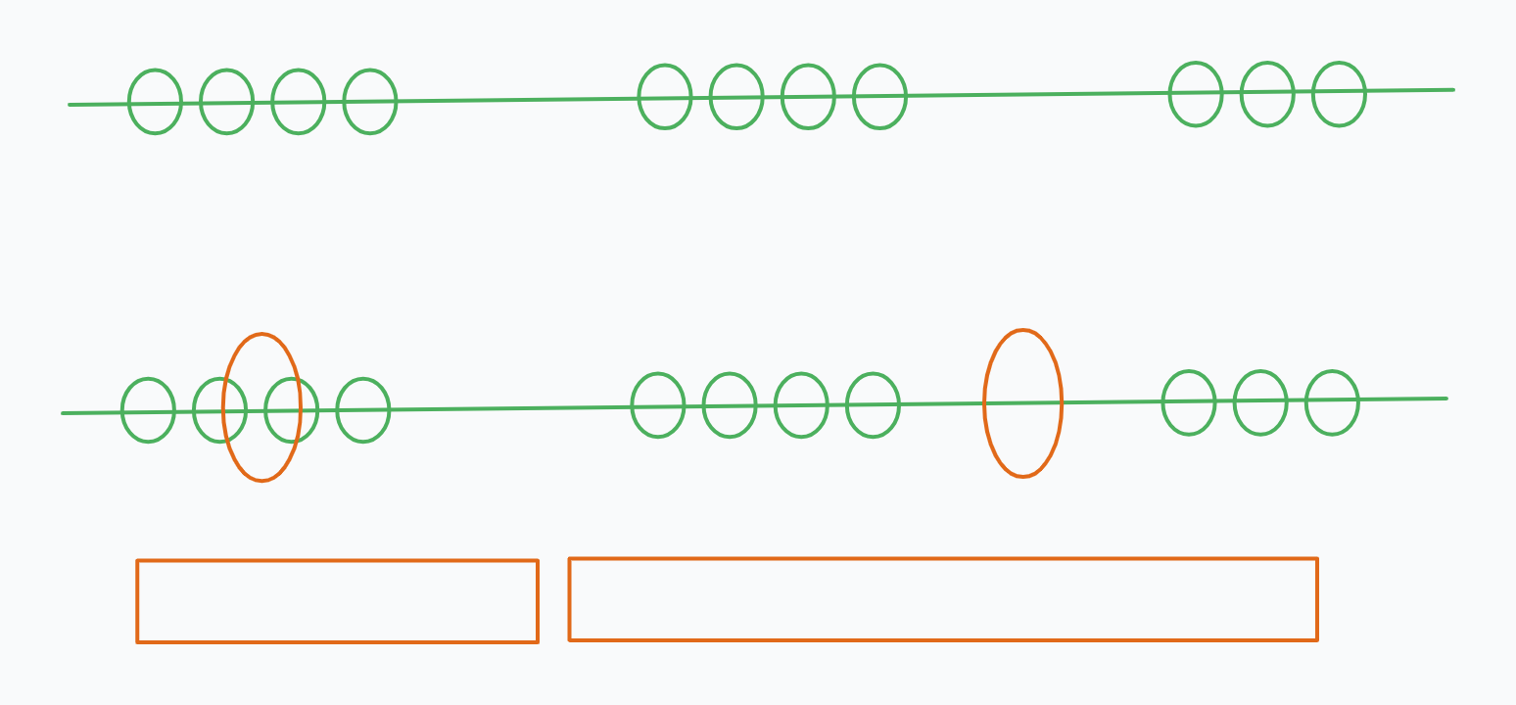
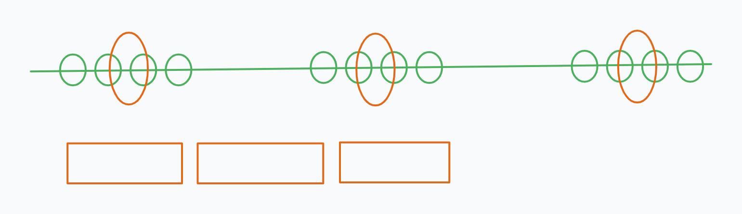
Steps in the Algorithm
Choosing K

Slide 13
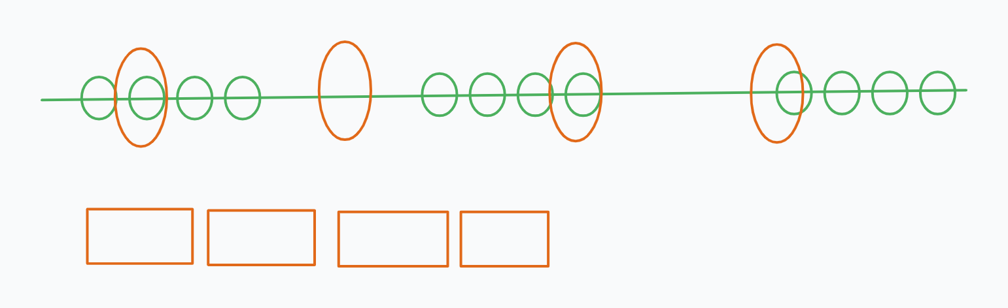
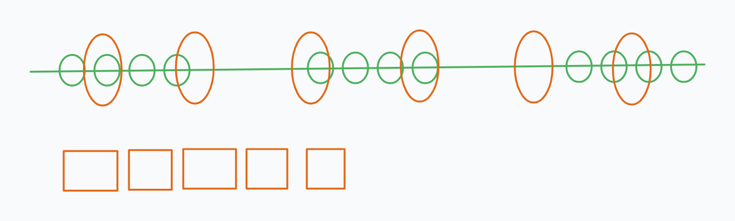
Steps in the Algorithm

Slide 14
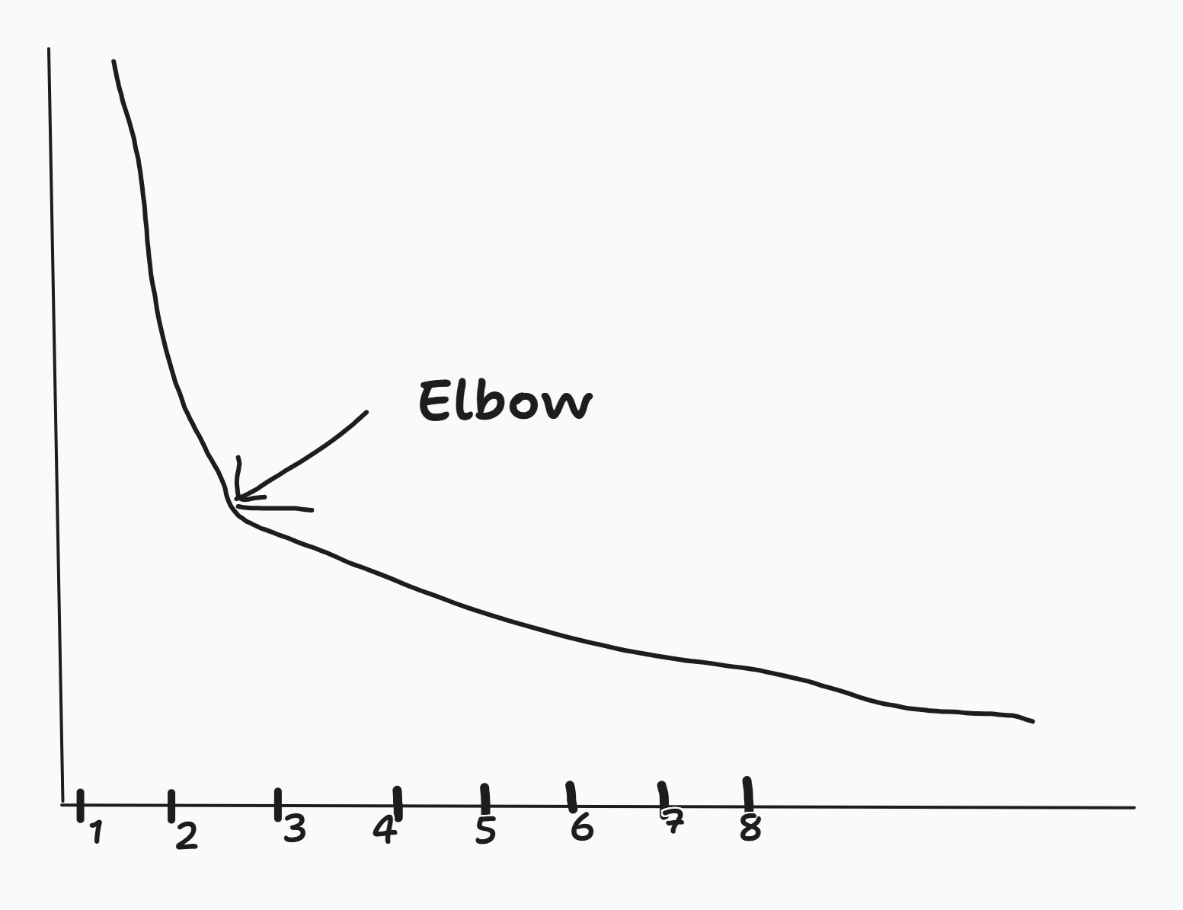
Steps in the Algorithm
Choosing K

Slide 15
Summary of K-Means Algorithm
Easy to use
Need to know K
May need to scale data
Good initial method
Local optima
No guarantee of optimal solution
Repeat with different starting values

Slide 16
K-means Lab

Slide 17
Hierachical Clustering

Slide 18

Key Concepts
Agglomerative vs Divisive : David
Dendrogram : David
Distance Similarity Matrix : Tracy
Linkage Criteria : Ivy
In Hierarchical Clustering, final clusters are built following a distinct set of sequential steps. Let’s explore this further (Next Slide)
a partition P1 into 1 clusters (the entire collection)
a partition P2 into 2 clusters
…
…
a partition Pn into n clusters (each object forms its own cluster)
The user decides which of the partitions reflects actual sub-populations in the data.

Slide 19
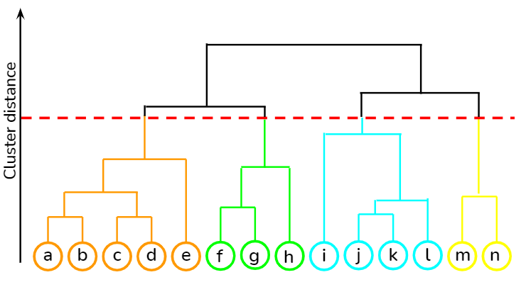
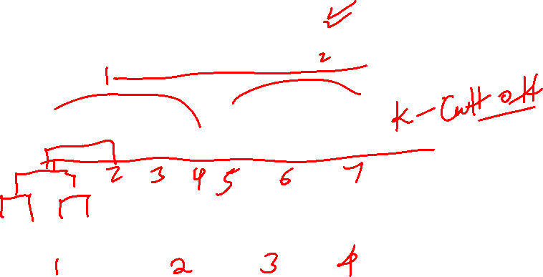
Hierarchical Cluster - Example
We decide the number of clusters we want

Slide 20

Agglomerative vs Divisive
Hierarchical methods again come in two varieties, agglomerative and divisive.
Agglomerative methods:
Start with partition Pn, where each object forms its own cluster.
Merge the two closest clusters, obtaining Pn-1.
Repeat merge until only one cluster is left.
Divisive methods
Start with P1.
Split the collection into two clusters that are as homogenous (and as different from each other) as possible.
Apply splitting procedure recursively to the clusters.

Slide 21
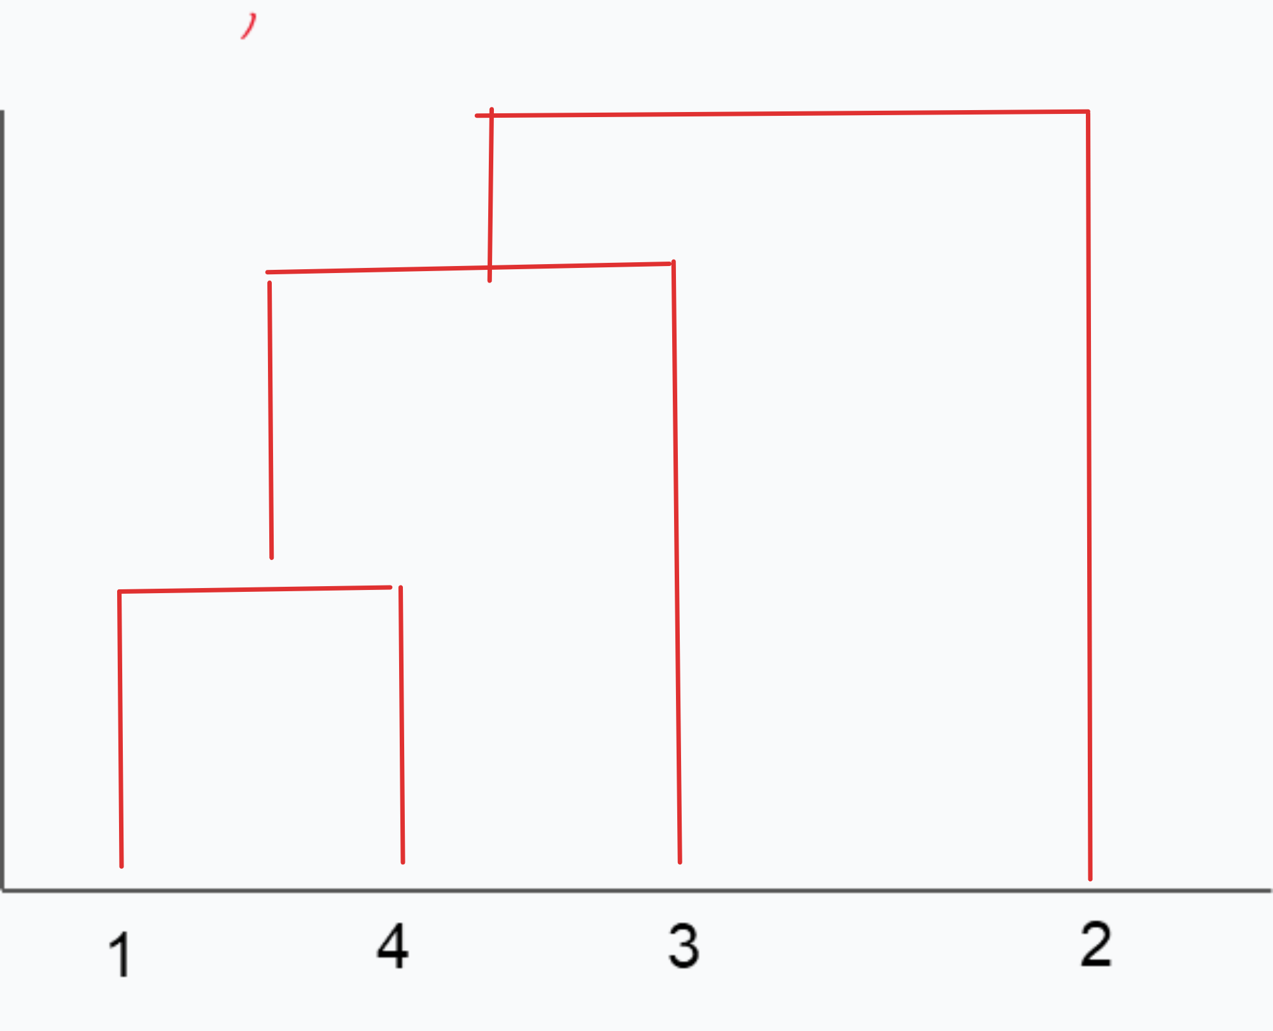
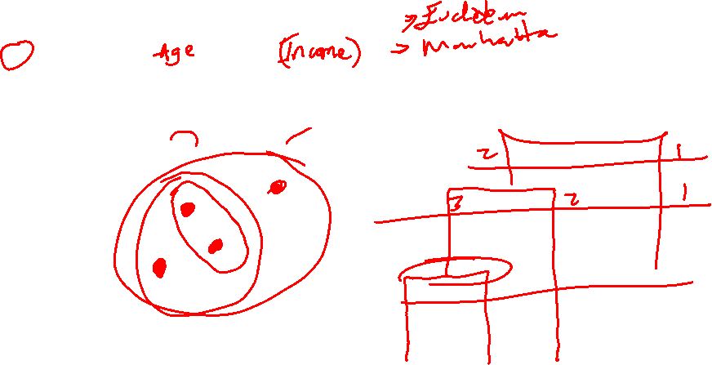
Dendrogram
ID | X1 | X2
1 | 5 | 6
2 | 10 | 9
3 | 3 | 4
4 | 4 | 8

Slide 22
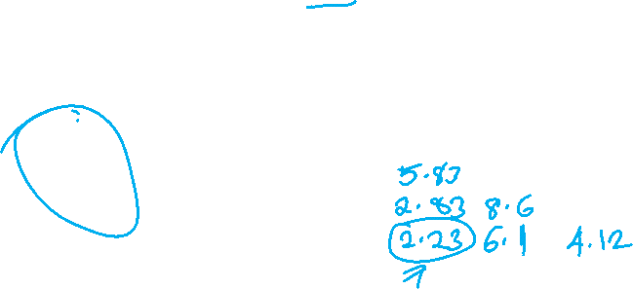
Distance Similarity Matrix
Using Euclidean Distance
d(1,2) = [(5-10) ² +(6-9)²]^{1/2}
d(1,3) = [(5-3) ² +(6-4)²]^{1/2}
d(1,4) = [(5-4) ² +(6-8)²]^{1/2}
ID | X1 | X2
1 | 5 | 6
2 | 10 | 9
3 | 3 | 4
4 | 4 | 8
ID | 1 | 2 | 3 | 4
1 | 0
2 |  | 0
3 |  |  | 0
4 |  |  |  | 0

Slide 23

Distance Similarity Matrix
Using Euclidean Distance
d(1,2) = [(5-10) ² +(6-9)²]^{1/2}
d(1,3) = [(5-3) ² +(6-4)²]^{1/2}
d(1,4) = [(5-4) ² +(6-8)²]^{1/2}
ID | X1 | X2
1 | 5 | 6
2 | 10 | 9
3 | 3 | 4
4 | 4 | 8
ID | 1 | 2 | 3 | 4
1 | 0
2 | 5.83 | 0
3 | 2.8 | 8.6 | 0
4 | 2.2 | 6.1 | 4.1 | 0

Slide 24
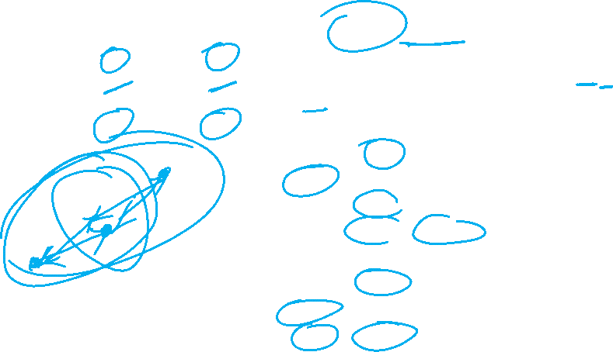
Distance Similarity Matrix
Using Centroid Linkage
Centre (4,1) = [(5+4)/2, (6+8)/2)] = (4.5,7)
d((4,1),2) = [(5-10) ² +(6-9)²]^{1/2}
ID | X1 | X2
1 | 5 | 6
2 | 10 | 9
3 | 3 | 4
4 | 4 | 8
ID | 4,1 | 2 | 3
4,1 | 0
2 | 5.9 | 0
3 | 3.35 | 8.6 | 0
ID | 4,1,3 | 2
4,1,3 | 0
2 | 7.5 | 0

Slide 25

Linkage Criteria
Many variants to defining closest pair of clusters
Single-link
  Similarity of the most cosine-similar (single-link)
Complete-link
  Similarity of the “furthest” points, the least cosine-similar
Centroid
  Clusters whose centroids (centers of gravity) are the most cosine-similar
Average-link
  Average cosine between pairs of elements

Slide 26
Single Linkage
Use maximum similarity of pairs:
Can result in “straggly” (long and thin) clusters due to chaining effect.
After merging c_{i} and c_{j}, the similarity of the resulting cluster to another cluster, c_{k}, is:

Slide 27
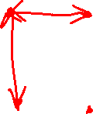
Complete Linkage
Use minimum similarity of pairs:
Makes “tighter,” spherical clusters that are typically preferable.
After merging c_{i} and c_{j}, the similarity of the resulting cluster to another cluster, c_{k}, is:
C_{i}
C_{j}
C_{k}

Slide 28
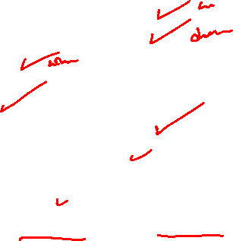
Summary of Hierarchical Clustering
Questions to ask
  How do you calculate the distance between clusters
  How do you tell which clusters are near each other
  Which points do you use
Advantages
  Easier to Implement
  Do not require one to specify the number of clusters
  Dendrogram can be used to understand results
Disadvantages
  Not Efficient for Large Datasets
  Does not produce the same results each time it is run, due to random initialization of centroids

Slide 29
Computational Complexity
In the first iteration, all HAC methods need to compute similarity of all pairs of N initial instances, which is O(N²).
In each of the subsequent N−2 merging iterations, compute the distance between the most recently created cluster and all other existing clusters.
In order to maintain an overall O(N²) performance, computing similarity to each other cluster must be done in constant time.
  Often O(N³) if done naively or O(N² log N) if done more cleverly

Slide 30
Hierarchical Clustering Lab
Check Out this Site for illustration of Hierarchical Clustering

Slide 31
Denisity Based Scan (DBSCAN)

Slide 32
Density-Based Clustering Methods
Clustering based on density (local cluster criterion), such as density-connected points or based on an explicitly constructed density function
Major features:
  Discover clusters of arbitrary shape
  Handle noise
  One scan
  Need density parameters
Several interesting studies:
  DBSCAN: Ester, et al. (KDD’96)
  DENCLUE: Hinneburg & D. Keim (KDD’98/2006)
  OPTICS: Ankerst, et al (SIGMOD’99).
  CLIQUE: Agrawal, et al. (SIGMOD’98)

Slide 33
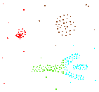
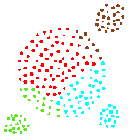
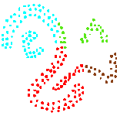
Density-based Approaches
Why Density-Based Clustering methods?
  Discover clusters of arbitrary shape.
  Clusters – Dense regions of objects separated by regions of low density
DBSCAN – the first density-based clustering
OPTICS – density-based cluster-ordering
DENCLUE – a general density-based description of cluster and clustering
Why Density-Based Clustering?
Results of a k-medoid
algorithm for k=4

Slide 34
Density-Based Clustering Methods
DBSCAN is a density-based algorithm.
  Density = number of points within a specified radius r (Eps)
  A point is a core point if it has more than a specified number of points (MinPts) within Eps
    These are points that are at the interior of a cluster
  A border point has fewer than MinPts within Eps, but is in the neighborhood of a core point
  A noise point is any point that is not a core point or a border point.

Slide 35
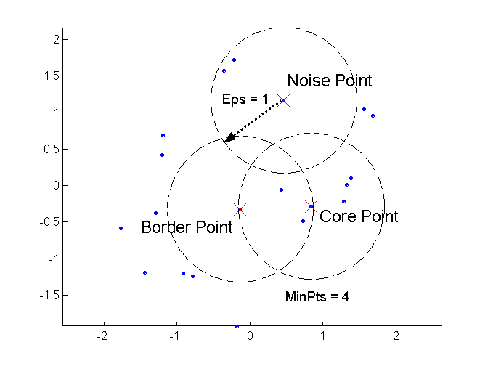
DBSCAN: Core, Border, and Noise Points
Outlier
Border
Core
ε = 1unit, MinPts = 5

Slide 36
DBSCAN Algorithm (simplified view for teaching)
Create a graph whose nodes are the points to be clustered
For each core-point c create an edge from c to every point p in the ε-neighborhood of c
Set N to the nodes of the graph;
If N does not contain any core points terminate
Pick a core point c in N
Let X be the set of nodes that can be reached from c by going forward;
  create a cluster containing X∪{c}
  N=N/(X∪{c})
Continue with step 4
Remark: points that are not assigned to any cluster are outliers;

Slide 37
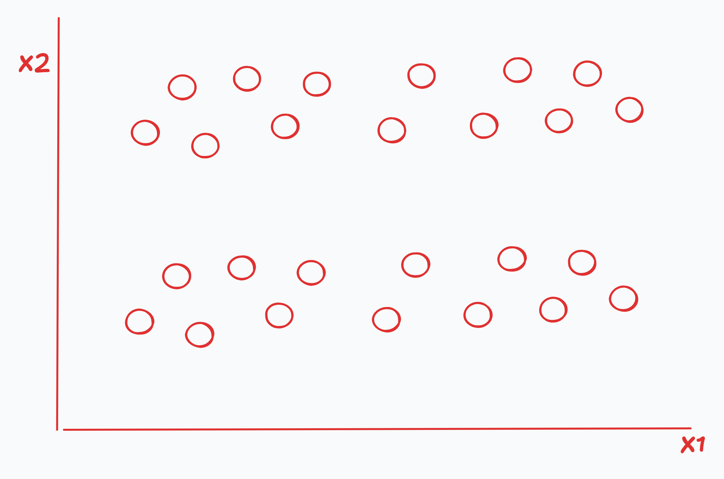
Steps in the Algorithm

Slide 38
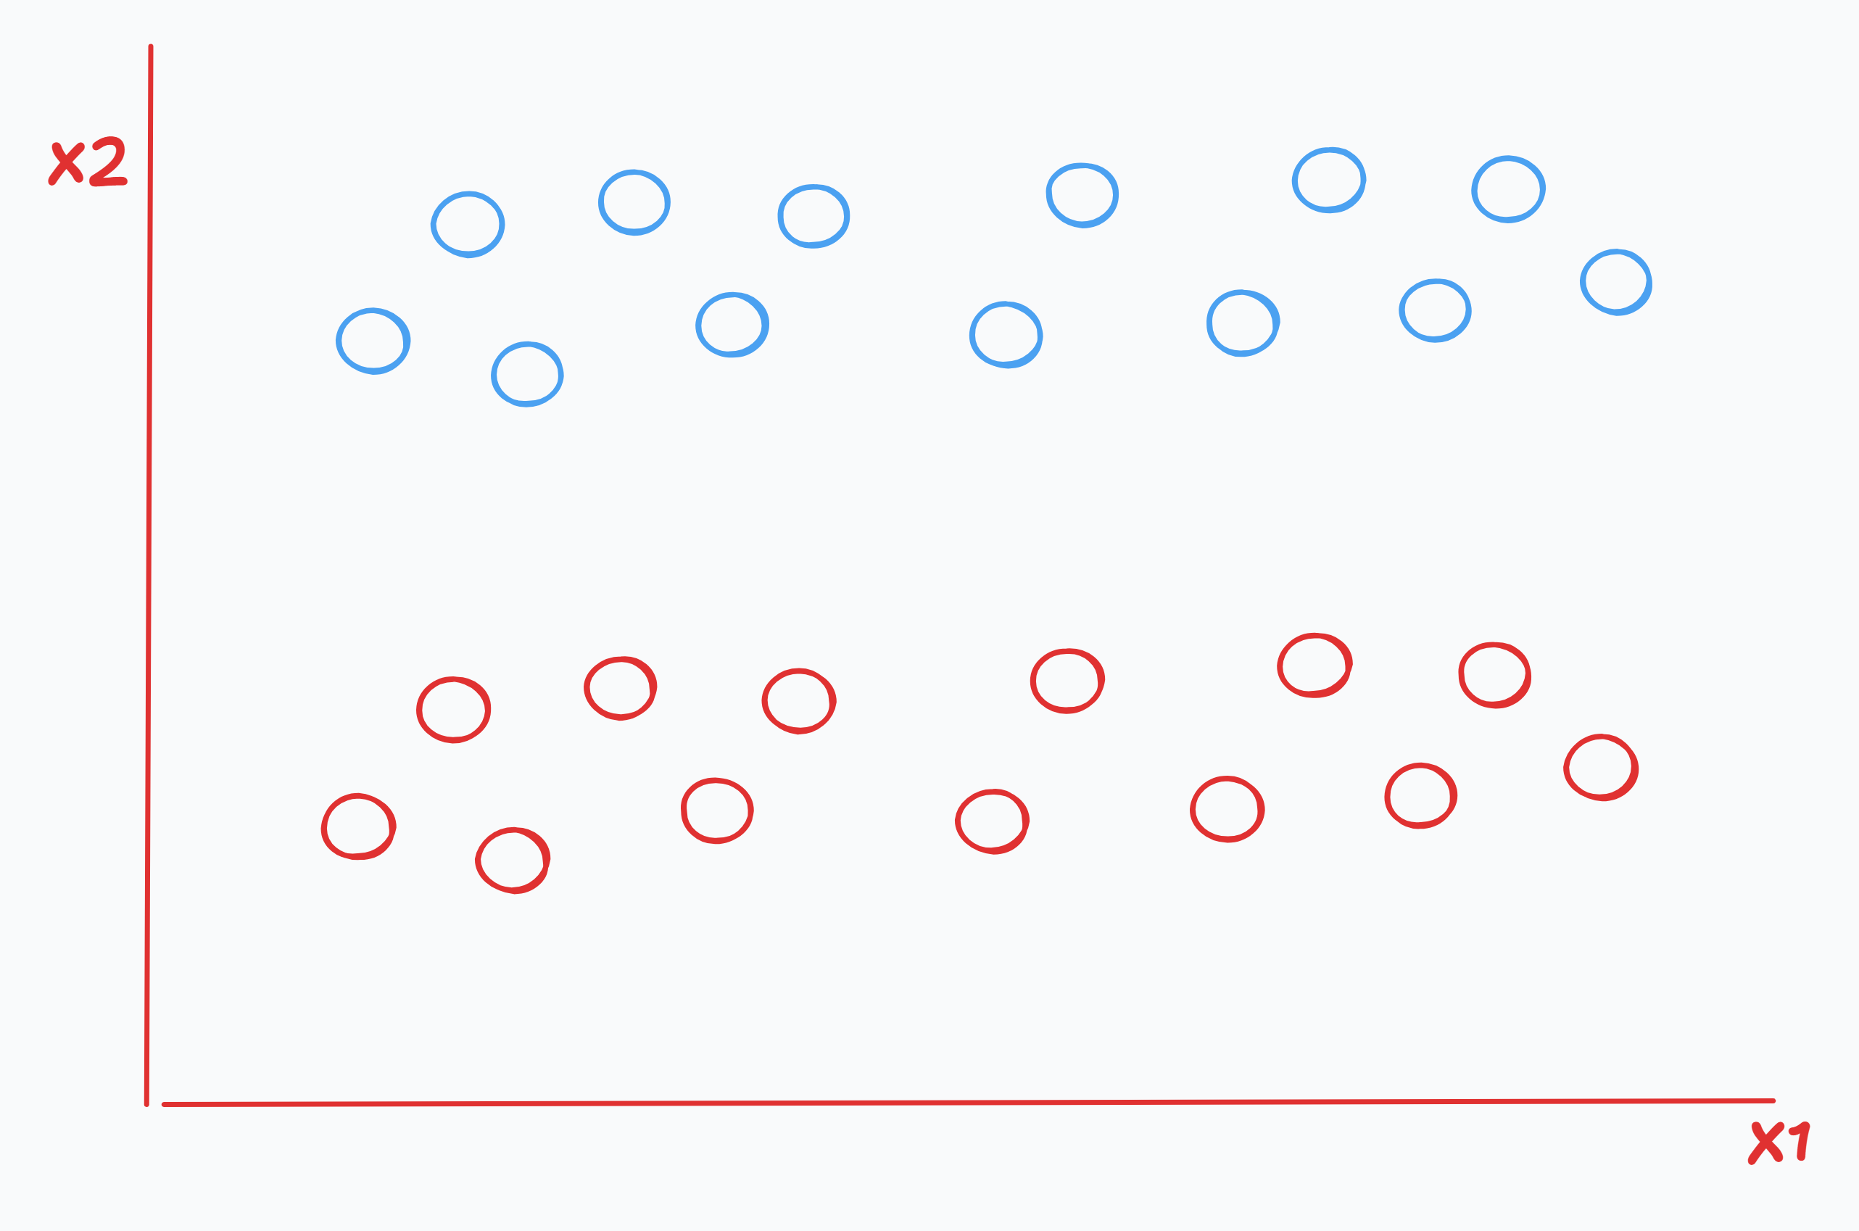
Steps in the Algorithm

Slide 39
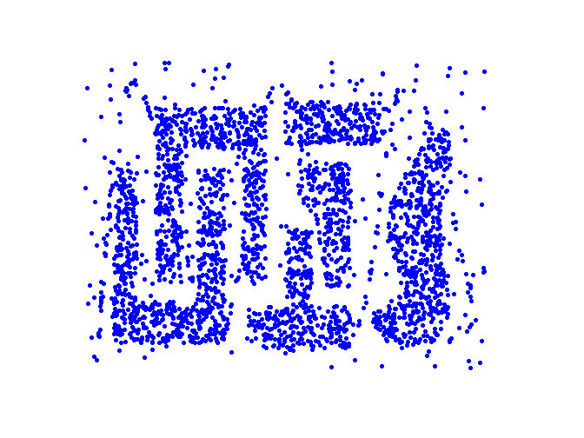
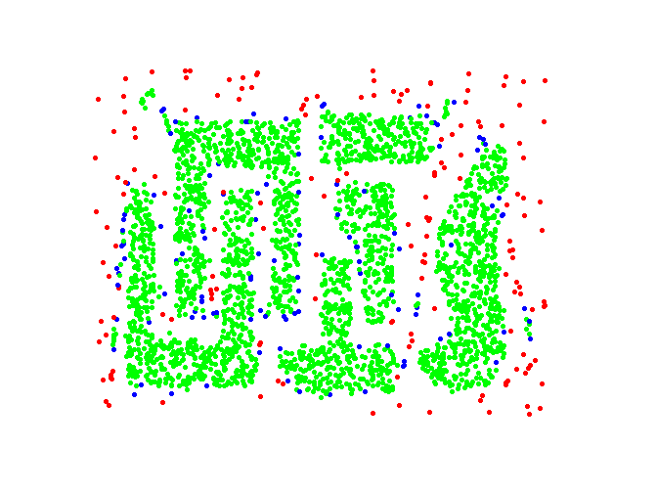
DBSCAN: Core, Border and Noise Points
Original Points
Point types: core, border and noise
Eps = 10, MinPts = 4

Slide 40
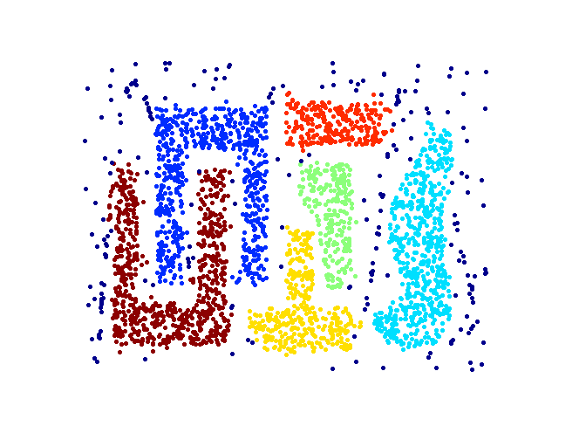
When DBSCAN Works Well
Clusters
Resistant to Noise
Can handle clusters of different shapes and sizes

Slide 41
When DBSCAN Works Well
Clusters
Resistant to Noise
Can handle clusters of different shapes and sizes

Slide 42
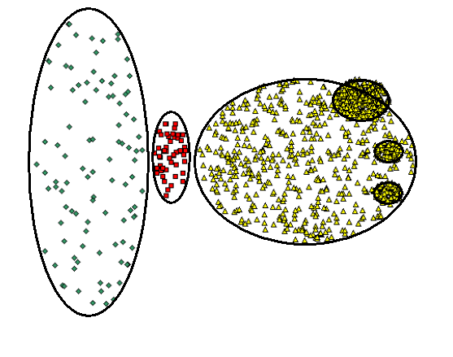
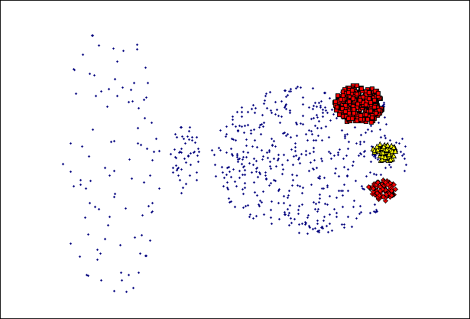
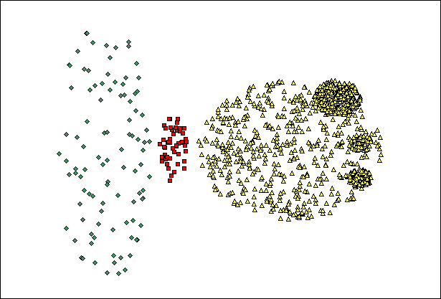
When DBSCAN Does NOT Work Well
(MinPts=4, Eps=9.75).
Original Points
(MinPts=4, Eps=9.92)
Varying densities
High-dimensional data

Slide 43
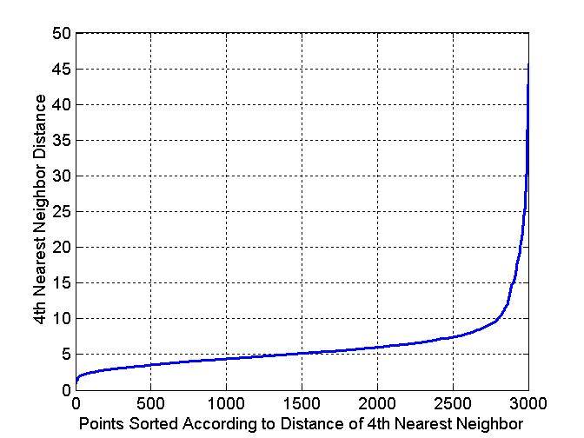
DBSCAN: Determining EPS and MinPts
Idea is that for points in a cluster, their k^{th} nearest neighbors are at roughly the same distance
Noise points have the k^{th} nearest neighbor at farther distance
So, plot sorted distance of every point to its k^{th} nearest neighbor
Run K-means for Minp=4 and not fixed
Core-points
Non-Core-points

Slide 44
Complexity DBSCAN
Time Complexity: O(n²)—for each point it has to be determined if it is a core point, can be reduced to O(n*log(n)) in lower dimensional spaces by using efficient data structures (n is the number of objects to be clustered);
Space Complexity: O(n).

Slide 45
Summary of DBSCAN
Good: can detect arbitrary shapes, not very sensitive to noise, supports outlier detection, complexity is kind of okay, beside K-means the second most used clustering algorithm.
Bad: does not work well in high-dimensional datasets, parameter selection is tricky, has problems of identifying clusters of varying densities (→SSN algorithm), density estimation is kind of simplistic (→does not create a real density function, but rather a graph of density-connected points)

Slide 46
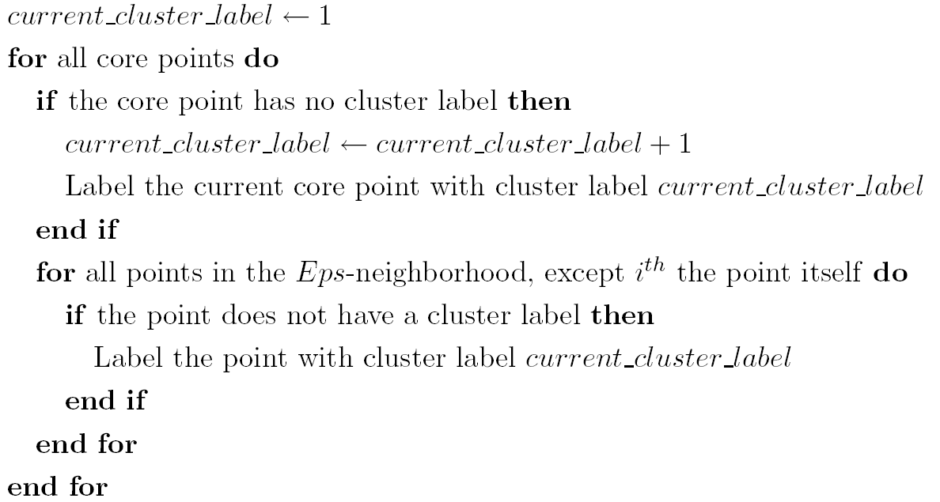
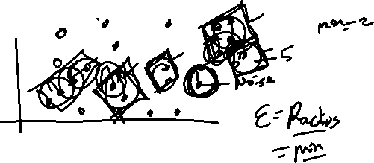
  Summary of DBSCAN
Eliminate noise points
Perform clustering on the remaining points:

Slide 47
DBSCAN Lab
Check Out this Site for Implementation of DBSCAN with different shapes

Slide 48
Density Estimation

Slide 49
Key Concepts

Slide 50
Gaussian Mixture Models (GMM)

Slide 51
Key Concepts

Slide 52
When to Use GMMs

Slide 53
GMMs Lab

Slide 54
Key Concepts

Slide 55
When to Use GMMs

Slide 56
GMMs Lab

Slide 57
Clustering Performance Evaluation

Slide 58
Clustering Evaluation Metrics

Slide 59
End…

